Slide 1
PRECONDITIONING ADMM FOR FAST DECENTRALIZED OPTIMIZATION
Team – 16
Ch.Priya madhav – CB.SC.U4AIE24211
B.Cibi kumar – CB.SC.U4AIE24212
G.G.Rishi kanth – CB.SC.U4AIE24218
T.Bala prassana kumar– CB.SC.U4AIE24256

Slide 2
Introduction
Decentralized optimization has become a key framework for addressing large-scale problems in distributed systems such as multi-agent networks, sensor networks, and federated learning.
It enables solving optimization tasks using only local computations and communication with neighboring nodes, reducing reliance on centralized control.
This work investigates the use of preconditioning strategies to enhance the performance and convergence of decentralized ADMM.

Slide 3
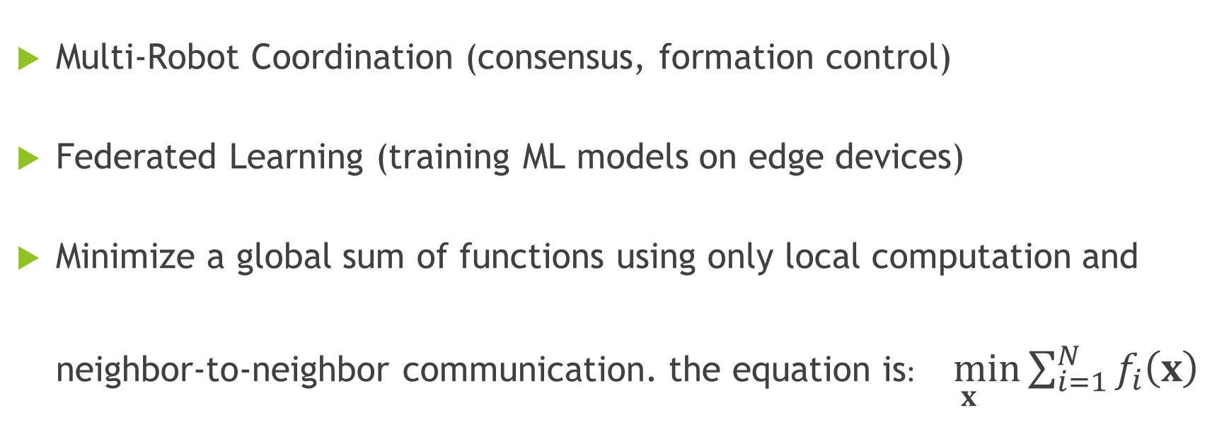
The Challenge of Decentralized Optimization
Multi-Robot Coordination (consensus, formation control)
Federated Learning (training ML models on edge devices)
Minimize a global sum of functions using only local computation and neighbor-to-neighbor communication. the equation is:$\min_{x}{\sum_{i=1}^{N}{f_{i}\left(x\right)}}$

Slide 4
Objective
Accelerate Convergence: Develop techniques that reduce the number of iterations and communication rounds required for decentralized ADMM to achieve consensus, thereby improving efficiency.
Integrate Preconditioning: Design and implement a fully decentralized preconditioning strategy that effectively addresses ill-conditioned local objectives and enhances overall stability.
Ensure Practicality: Maintain scalability, privacy-preservation, and a balanced computation–communication trade-off, ensuring the method is suitable for real-world distributed systems.

Slide 5
Preconditioning: A Classic Idea for Acceleration
What is Preconditioning?
Transforming a problem into a better-conditioned one that has the same solution.
Analogy: "It's easier to climb a hill after it's been terraced into gentler slopes.“
Standard Use: In gradient methods and Conjugate Gradient, preconditioning is crucial for ill-conditioned problems.
Only the local computation changes. The preconditioning is fully decentralized.

Slide 6
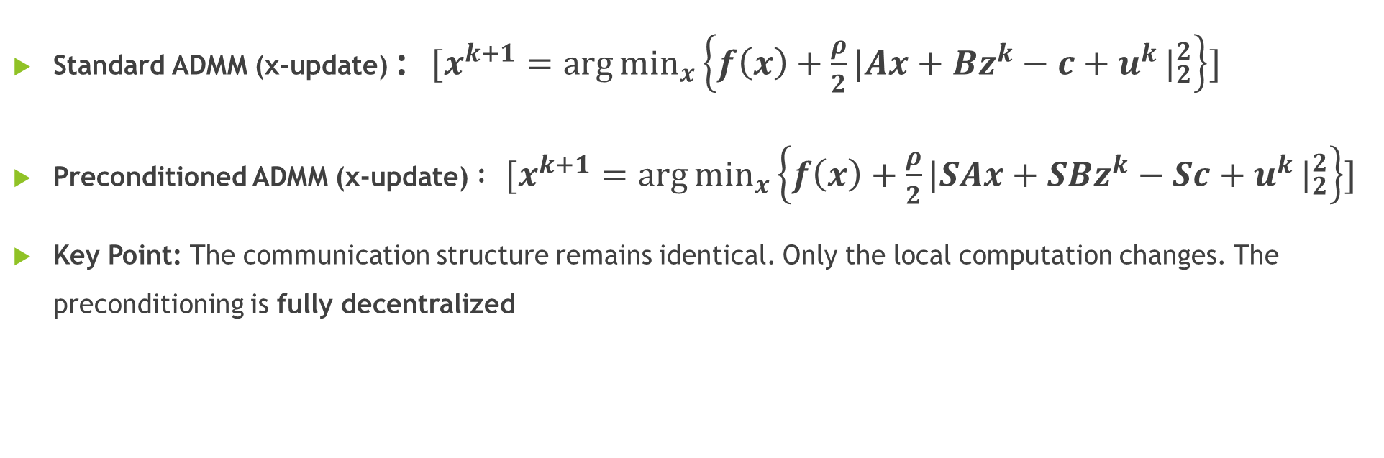
Algorithm Design: Standard vs. Preconditioned ADMM
Standard ADMM (x-update) : $[x^{k+1}=\arg{\min_{x}\left\{f\left(x\right)+\frac{ρ}{2}\left.|Ax+Bz^{k}−c+u^{k}\right.|_{2}^{2}\right\}}]$
Preconditioned ADMM (x-update) $: [x^{k+1}=\arg{\min_{x}\left\{f\left(x\right)+\frac{ρ}{2}\left.|SAx+SBz^{k}−Sc+u^{k}\right.|_{2}^{2}\right\}}]$
Key Point: The communication structure remains identical. Only the local computation changes. The preconditioning is fully decentralized

Slide 7
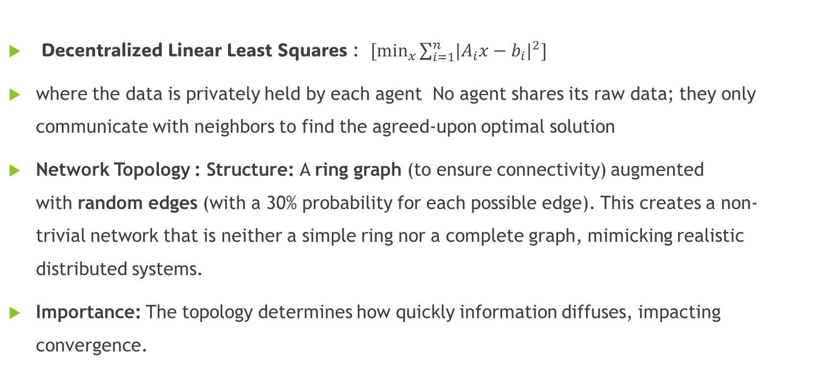
Simulation Setup
Decentralized Linear Least Squares : $[\min_{x}{\sum_{i=1}^{n}{\left.|A_{i}x−b_{i}\right.|^{2}}}]$
where the data is privately held by each agent No agent shares its raw data; they only communicate with neighbors to find the agreed-upon optimal solution
Network Topology : Structure: A ring graph (to ensure connectivity) augmented with random edges (with a 30% probability for each possible edge). This creates a non-trivial network that is neither a simple ring nor a complete graph, mimicking realistic distributed systems.
Importance: The topology determines how quickly information diffuses, impacting convergence.

Slide 8
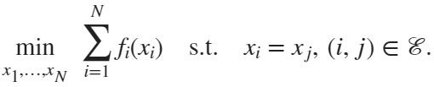


OPTIMIZATION PROBLEM

Slide 9






Slide 10
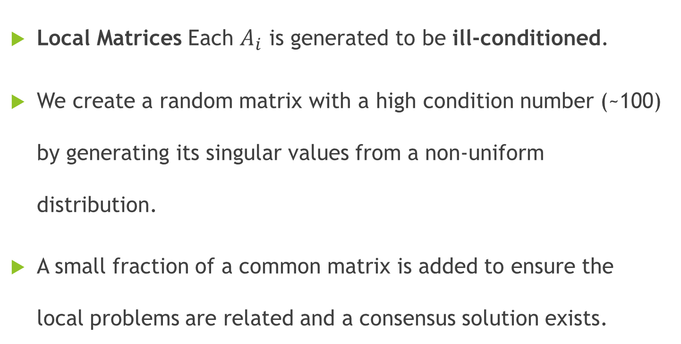
Data Generation
Local Matrices Each $A_{i}$ is generated to be ill-conditioned.
We create a random matrix with a high condition number (~100) by generating its singular values from a non-uniform distribution.
A small fraction of a common matrix is added to ensure the local problems are related and a consensus solution exists.

Slide 11
Conclusion
Preconditioning effectively accelerates the convergence of decentralized ADMM by mitigating ill-conditioning.
The proposed approach improves efficiency while preserving full decentralization and scalability.
It offers a practical and easily integrable solution for real-world distributed optimization problems.

Slide 12
Thank you

